Slide 1
Lecture – 18

Slide 2
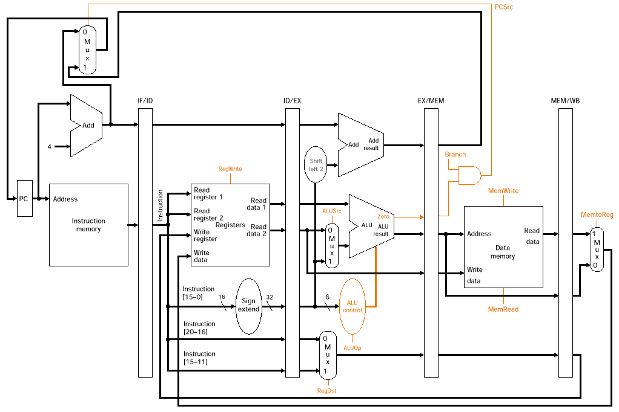
Pipelined Datapath with Control Signals

Slide 3
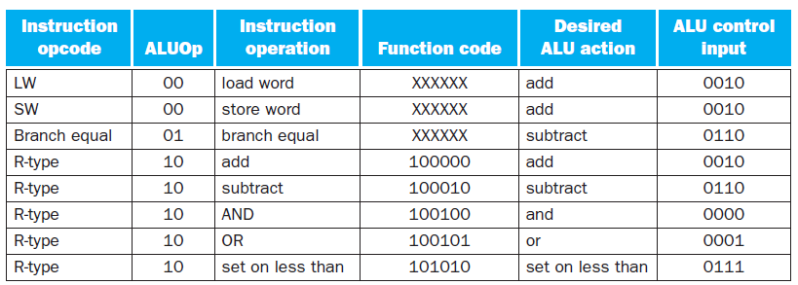
Control Signal for the Pipeline Datapath

Slide 4
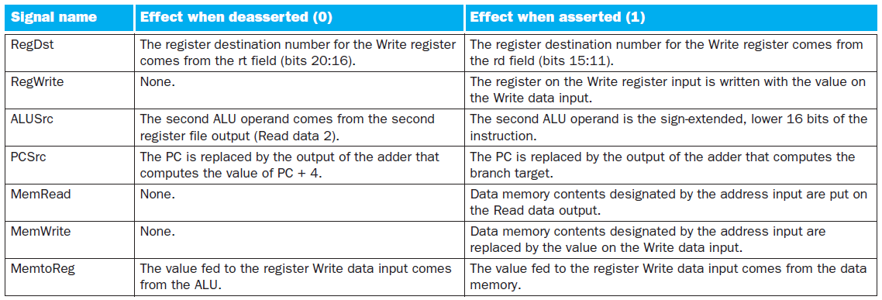
Control Signal for the Pipeline Datapath

Slide 5
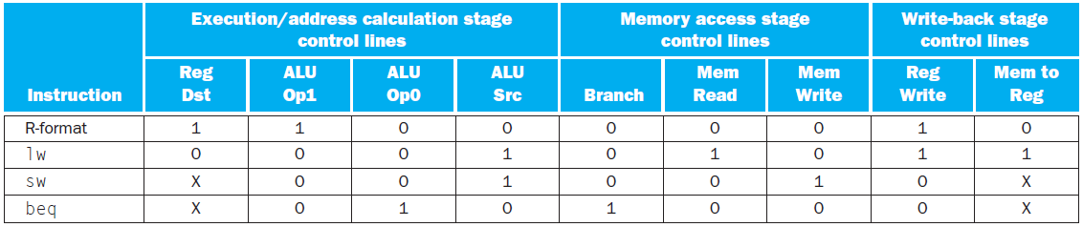
Control Signal for the Pipeline Datapath

Slide 6
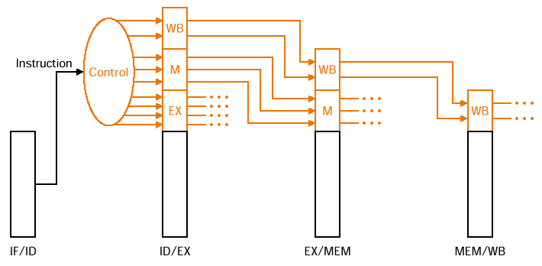
Control Signals Generation
RegDst, ALUOp, ALUSrc
Branch, MemRead, MemWrite
MemtoReg, RegWrite

Slide 7
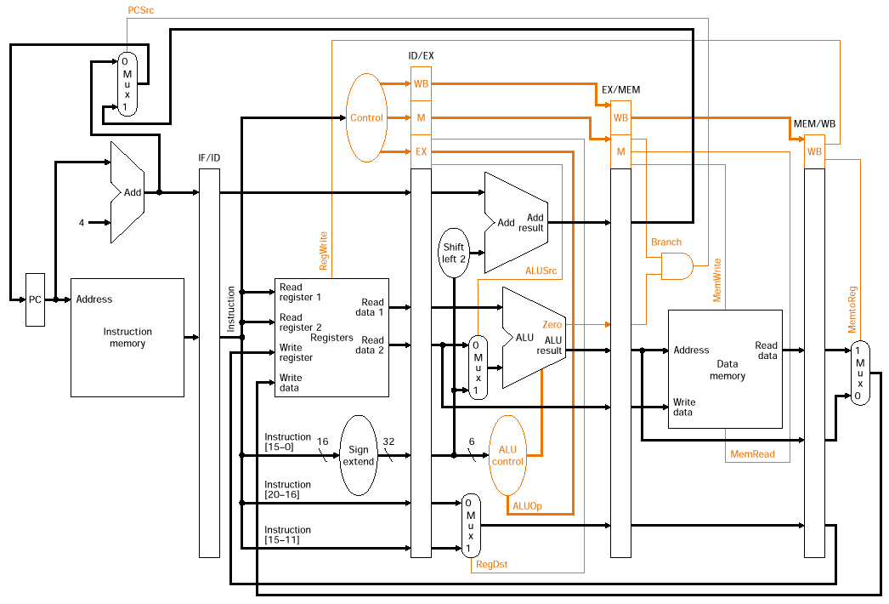
Pipelined Datapath with control Signals Connected

Slide 8
Example
lw $10, 20($1)
sub $11, $2, $3
and $12, $4, $5
or $13, $6, $7
add $14, $8, $9

Slide 9
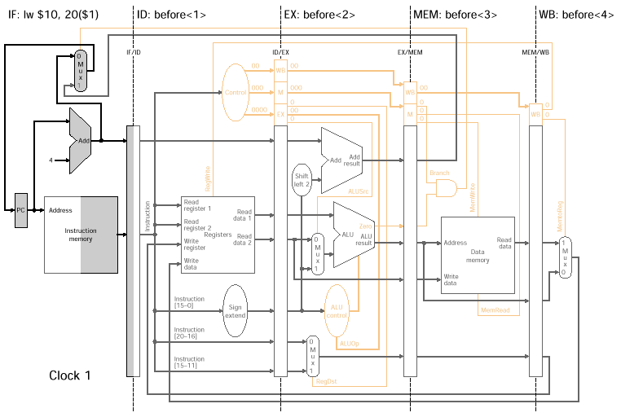
Example

Slide 10
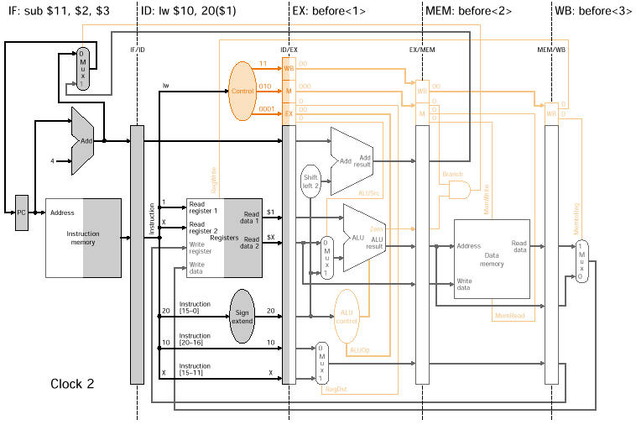
Example

Slide 11
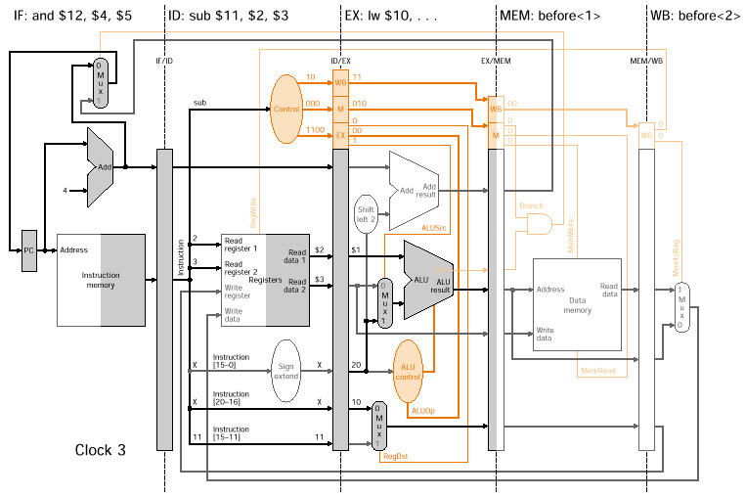
Example

Slide 12
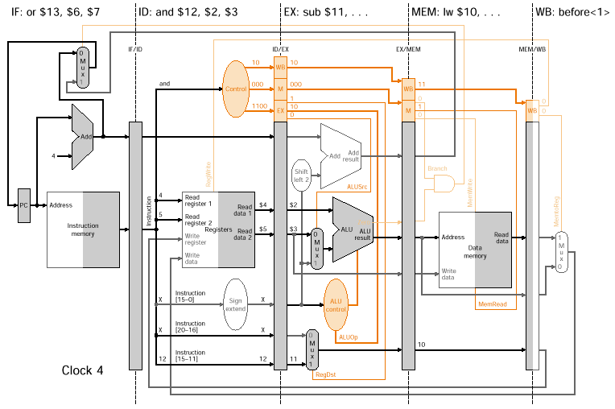
Example

Slide 13
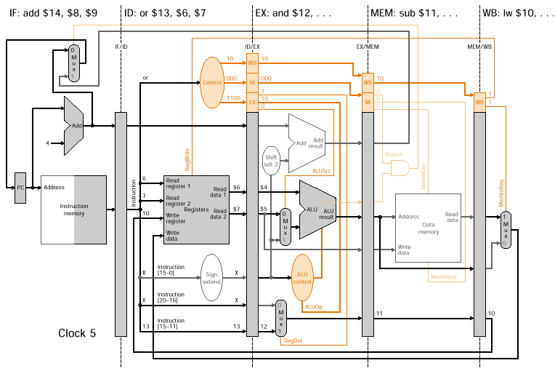
Example

Slide 14
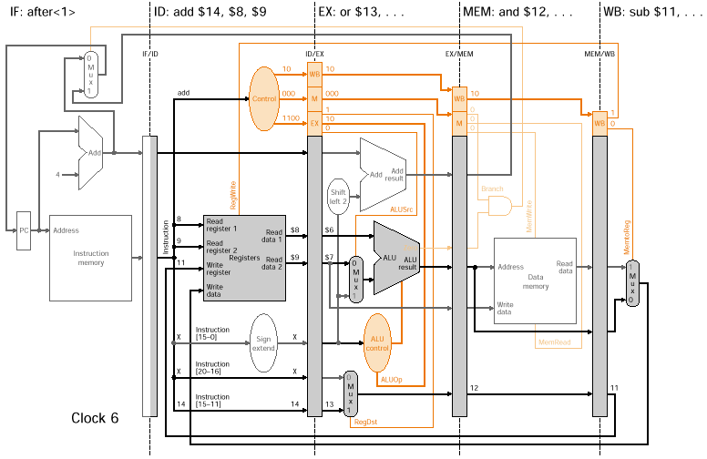
Example

Slide 15
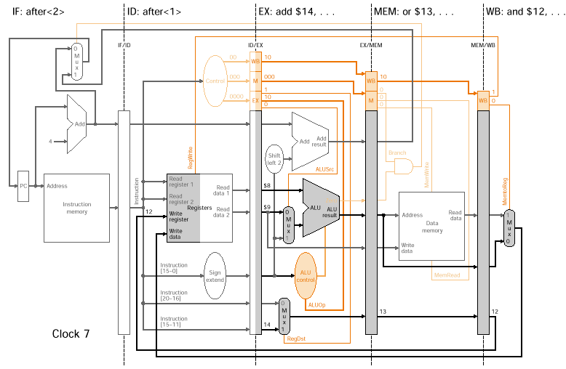
Example

Slide 16
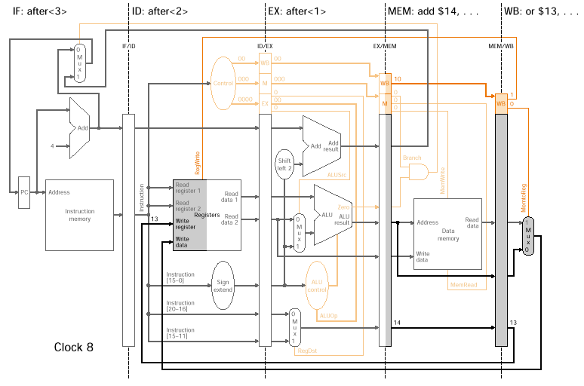
Example

Slide 17
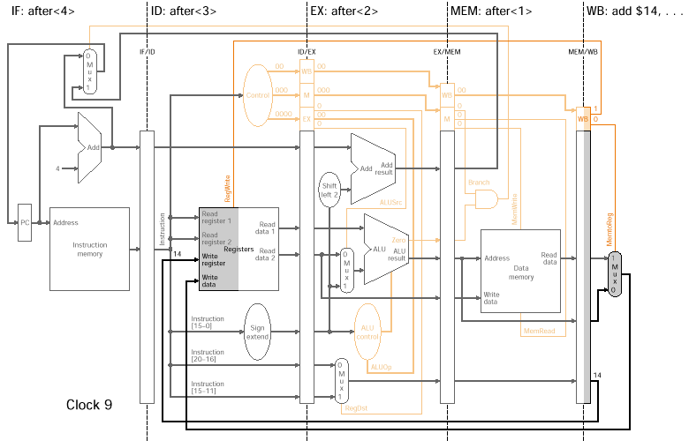
Example

Slide 18
Data Hazards
Consider the following code segments:
sub $2, $1, $3 //$2 written by sub
and $12, $2, $5 //1st operand ($2) depends on sub
or $13, $6, $2 //2nd operand ($2) depends on sub
add $14, $2, $2 //1st ($2) and 2nd ($2) operand depend on sub
sw $15, 100($2) //base ($2) depends on sub
One hazard resolved by the design of register file. Write in the first half of the clock cycle and the read in the second half. So read delivers what is written.

Slide 19
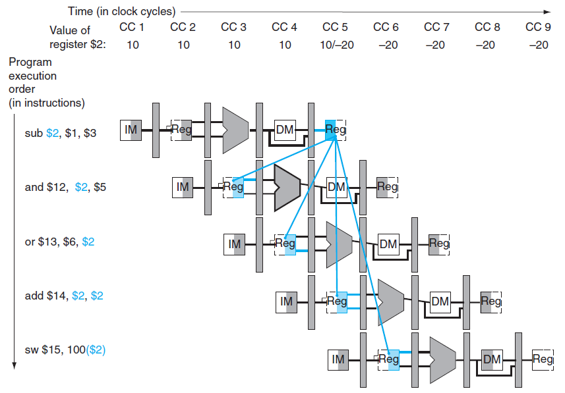

Pipelined Dependences

Slide 20
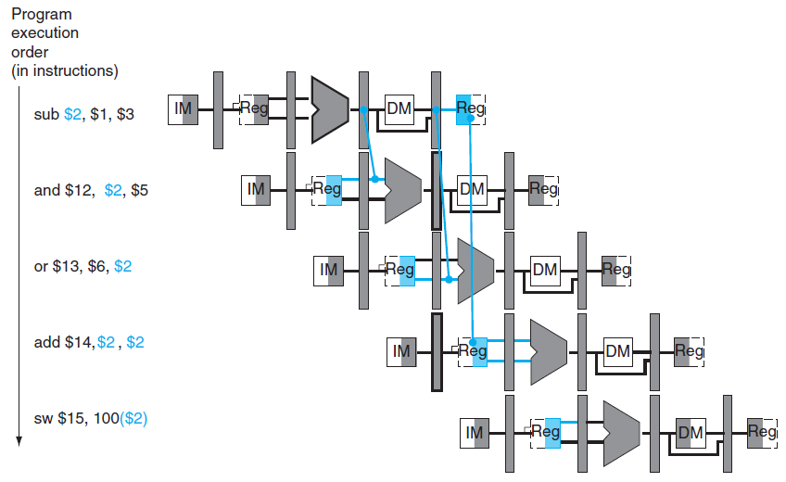
Fixing Data Hazard by Forwarding
Notes:
Notice that for now we are showing the forwarded data coming out of the ALU. After looking at the problem more closely we will see that it really is supplied by the pipeline register EX/MEM and will depict it as such.

Slide 21
Data Forwarding
Data can be forwarded from EX/MEM register and MEM/WB registers.
Forward by taking the inputs to the ALU from any pipeline register rather than just ID/EX by
  adding multiplexors to the inputs of the ALU so can pass Rd back to either (or both) of the EX’s stage Rs and Rt ALU inputs
  00: normal input (ID/EX pipeline registers)
  10: forward from previous instr (EX/MEM pipeline registers)
  01: forward from instr 2 back (MEM/WB pipeline registers)
  adding the proper control hardware
With forwarding can run at full speed even in the presence of data dependencies

Slide 22
Two Pairs of Hazard Conditions
EX/MEM Hazard:
1a.if (EX/MEM.RegisterRd ==ID/EX.RegisterRs)
forwardA=10 [Between sub and and]
1b. If (EX/MEM.RegisterRd == ID/EX.RegisterRt)
forwardB=10
MEM/WB Hazard:
2a. If (MEM/WB.RegisterRd == ID/EX.RegisterRs)
forwardA=01
2b. If (MEM/WB.RegisterRd == ID/EX.RegisterRt)
forwardB=01 [Between sub and or]

Slide 23
Hazard Conditions
EX/MEM hazard:
if (EX/MEM.RegWrite
and (EX/MEM.RegisterRd == ID/EX.RegisterRs))
ForwardA = 10
if (EX/MEM.RegWrite
and (EX/MEM.RegisterRd == ID/EX.RegisterRt))
ForwardB = 10
MEM/WB hazard:
if (MEM/WB.RegWrite
and (MEM/WB.RegisterRd == ID/EX.RegisterRs))
ForwardA = 01
if (MEM/WB.RegWrite
and (MEM/WB.RegisterRd == ID/EX.RegisterRt))
ForwardB = 01
Forwards the result from the previous instr. to either input of the ALU provided it writes.
Forwards the result from the second previous instr. to either input of the ALU provided it writes.

Slide 24
Hazard Conditions
EX/MEM hazard:
if (EX/MEM.RegWrite
and (EX/MEM.RegisterRd != 0)
and (EX/MEM.RegisterRd == ID/EX.RegisterRs))
ForwardA = 10
if (EX/MEM.RegWrite
and (EX/MEM.RegisterRd != 0)
and (EX/MEM.RegisterRd == ID/EX.RegisterRt))
ForwardB = 10
MEM/WB hazard:
if (MEM/WB.RegWrite
and (MEM/WB.RegisterRd != 0)
and (MEM/WB.RegisterRd == ID/EX.RegisterRs))
ForwardA = 01
if (MEM/WB.RegWrite
and (MEM/WB.RegisterRd != 0)
and (MEM/WB.RegisterRd == ID/EX.RegisterRt))
ForwardB = 01
Forwards the result from the previous instr. to either input of the ALU provided it writes and != 0.
Forwards the result from the second previous instr. to either input of the ALU provided it writes and != 0

Slide 25
Datapath with Forwarding Hardware
PCSrc
1
0
ID/EX
EX/MEM
Control
IF/ID
Add
MEM/WB
Add
Branch
4
Shift
left 2
Instruction
Memory
Read Addr 1
Data
Memory
Register
File
Read
Data 1
Read Addr 2
PC
Read
Address
Read
Data
Write Addr
ALU
Address
1
Read
Data 2
1
Write Data
Write Data
0
0
ALU
cntrl
16
Sign
Extend
32
0
1
Forward
Unit
Notes:
For class handout

Slide 26
Datapath with Forwarding Hardware
PCSrc
1
0
ID/EX
EX/MEM
Control
IF/ID
Add
MEM/WB
Add
Branch
4
Shift
left 2
Instruction
Memory
Read Addr 1
Data
Memory
Register
File
Read
Data 1
Read Addr 2
PC
Read
Address
Read
Data
Write Addr
ALU
Address
1
Read
Data 2
1
Write Data
Write Data
0
0
ALU
cntrl
16
Sign
Extend
32
0
EX/MEM.RegisterRd
1
IF/ID.RegisterRs
Forward
Unit
MEM/WB.RegisterRd
IF/ID.RegisterRt
Notes:
For lecture.
How many bits wide is each pipeline register now?
ID/EX – 9 + 32x4 + 10 = 147 + 10 = 157
Control line inputs to Forward Unit EX/MEM.RegWrite and MEM/WB.RegWrite not shown on diagram

Slide 27
Yet Another Complication!
Another potential data hazard can occur when there is a conflict between the result of the WB stage instruction and the MEM stage instruction – which should be forwarded? More recent result!
I
n
s
t
r.
O
r
d
e
r
add $1,$1,$2
IM
Reg
ALU
DM
Reg
add $1,$1,$3
IM
Reg
ALU
DM
Reg
add $1,$1,$4
IM
Reg
ALU
DM
Reg

Slide 28
Hazard Conditions
MEM/WB hazard:
if (MEM/WB.RegWrite
and (MEM/WB.RegisterRd != 0)
and (EX/MEM.RegisterRd != ID/EX.RegisterRs)
and(MEM/WB.RegisterRd == ID/EX.RegisterRs))
ForwardA = 01
if (MEM/WB.RegWrite
and (MEM/WB.RegisterRd != 0)
and (EX/MEM.RegisterRd != ID/EX.RegisterRt )
and (MEM/WB.RegisterRd == ID/EX.RegisterRt))
ForwardB = 01

Slide 29
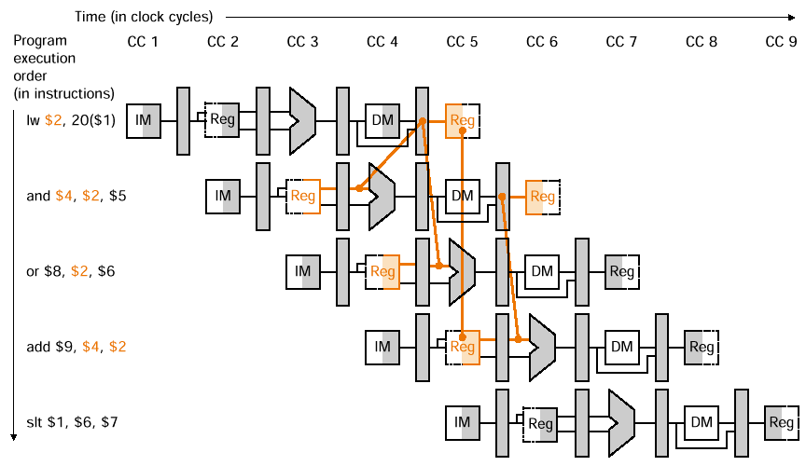
Data Hazard Requiring a Stall

Slide 30
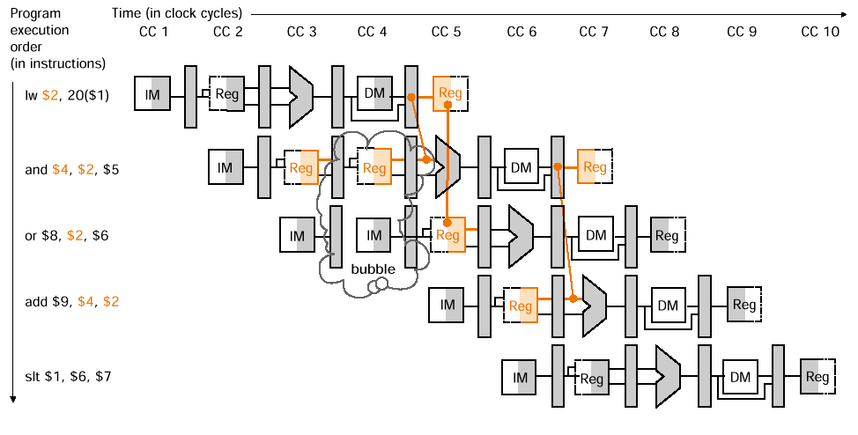
Data Hazard Requiring a Stall

Slide 31
Hazard Detection Unit
We need hazard detection unit beside the forwarding unit.
It operates during the ID stage so that it can insert the stall between the load and it’s use.
Condition
if (ID/EX.MemRead and
((ID/EX.RegisterRt = IF/ID.RegisterRs) or
(ID/EX.RegisterRt = IF/ID.RegisterRt)))
stall the pipeline

Slide 32
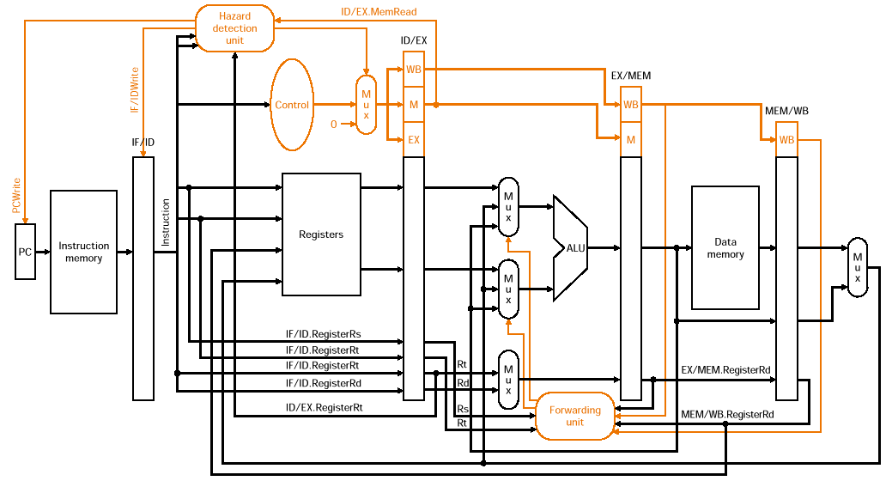
Stall Logic

Slide 33
Nops
Both instructions in ID and IF stage must be stalled.
For this reason, the PC register and the IF/ID register are preserved.
The EX stage must do nops.
To insert nops we must deassert all nine control signal in EX, MEM and WB stage.

